Slide 1
Constructing Requirements: Improving Success of HIT Projects
May 25, 2017 10:30-11:20 David Gibbs, PhD, CPHIMS Assistant Professor, Texas State University San Marcos, TX

Slide 2
Conflict of Interest Disclosure
David Gibbs, PhD
Has no real or apparent conflicts of interest to report.

Slide 3
Learning Objectives
Identify common challenges faced when eliciting requirements for health information systems
Recognize circumstances related to requirement elicitation that indicate risks of failure for deploying health information systems
Contrast positivist and constructivist approaches to eliciting requirements
Propose approaches to address common requirements challenges

Slide 4
Agenda
Problem
Research Questions
Perspective
Challenges Identified
Requirements as Knowledge
Applying to HIT Lifecycles
Recommendations

Slide 5
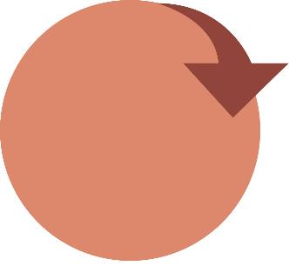
Realizing the Value of Health IT
Satisfaction of stakeholders
Risk of wasted time and resources

Slide 6
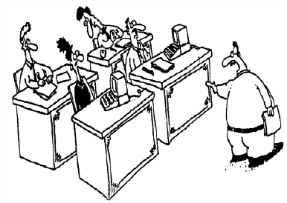
Inspiration from 25+ years ago
Y’all start building the solution… …I’ll go ask what they want
(Unknown artist, numerous Internet sources)

Slide 7
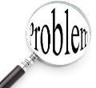
The Problem
“The hardest single part of building a software system is deciding precisely what to build.” (Fred Brooks, 1987)

Slide 8
The Problem
“The difficulties encountered in accurately capturing system requirements have been suggested to be a major factor in the failure of 90% of large software projects.” (Davis, et al., 2006)
“It is clear that requirements elicitation has not been done well and that failure causes considerable problems.” (Davey & Cope, 2008)

Slide 9
The Problem Continues…
“Studies show that 80 to 85 percent of project failures are due to incorrect requirements.” (Don Reinertsen, 2011)
“Research suggests that requirements engineering is not well done in industry.” (Phillip Laplante, 2014)

Slide 10
The Problem Applies to Healthcare
“A great opportunity for promoting HIT was lost because of inadequate communications with stakeholders. Even when project technologists have clinical background, they do not speak for everyone.” (Jonathan Leviss, 2010)
“Clinical information technology (IT) projects are highly complex social endeavors in unforgiving medical environments that happen to involve computers, not IT projects that happen to involve clinicians.” (Jonathan Leviss, 2010)

Slide 11
The Problem Applies to Healthcare
“One of the reasons for failure in EHR implementation is usually because management has not taken the time to fully assess its needs.” (Mohamed Merhi, 2015)

Slide 12
Customer
Project Lead
Analyst
Programmer
Consultant
Documenter
Operations
Billing
Support
Needed
http://www.projectcartoon.com with titles added.
Creative Commons Attribution 3.0 Generic License.

Slide 13
The Question
Fundamental Question
Why is it so difficult to determine requirements?
Refined into the Research Question
What challenges are encountered by stakeholders when identifying requirements for information systems?

Slide 14
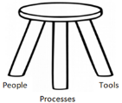
Researcher’s Perspective
Experience
30 years designing/developing/delivering information systems
10 years in HIT/HIM
Direct observation across many projects
Access
Information Systems Architect for a large technology company
Supporting complex projects for healthcare and government
Access to experienced colleagues and customers
Interests
Adult, Professional, and Community Education
People-side of information systems
Healthcare
Computer Science
Adult Education
People
Products
Process

Slide 15
Three-Legged Stool
Visual aid for Information Systems
Interrelated components
Must attend to all three to have a stable platform (Williams & Duray, 2013)
Applicable to Electronic Health Record systems
“…not only hardware and software, but also people…and process” (Amatayakul, 2013)
People
Process
Products (Technology)

Slide 16
Sensitizing Concepts
Requirements are subjective expectations
Systems don’t have requirements, people do
Constructivism vs. Positivism
Requirements must be constructed through collaboration
“The fundamental problem here is that folks believe that underlying every project there’s some absolute, discoverable set of requirements.” (Thomas & Hunt, 2004)
Stakeholder Turnover
Adding or removing a stakeholder may change requirements

Slide 17
Resolving Conflicting Requirements
“Instead of dealing with that issue … we kind of tabled the issue … it didn’t go away and when it came time to deliver it … hadn’t been resolved. I see that very consistently in the requirements processes that people tend to push off things that are difficult or not politically expedient and those things never go away and they ultimately reveal themselves … after a lot of time and a lot of money has been spent.”
Stakeholder on a project that was cancelled due to disappointing results
Identify show stoppers sooner rather than later

Slide 18
Power
“These are not people you want to disappoint. They are more trusted than you are with the boss and the boss’ boss. And so there is political cost to [speaking up].”
A stakeholder who knew failure was inevitable
“The staff in the surgical clinic thought that they had no influence in the system design and development.” (Leviss, 2010)
On stakeholders who did not feel empowered
“They talked to my boss, who was an arrogant SOB, and they did not talk to anybody else. They just came to all these conclusions that he knew what he was talking about.”
A stakeholder on a project that exceeded budget and disappointed users
Power issues may obstruct openness and hide requirements

Slide 19
Turnover
“You would have individuals that came in with different priorities or different visions of what they think, which was different than the last [leader]…. Priorities would change to meet the priority of the new individual.”
Stakeholder on a project with changing requirements
“It’s not like you could go and ask someone what did you mean when you wrote this? Those people were long gone by that time.”
Stakeholder on a project cancelled after 10+ years of effort
Requirements are from people, not systems

Slide 20
Diverse Perspectives
“It’s a cultural problem.”
Offshore development for insurance system
“He had a real issue dealing with women.”
Lack of respect inhibited collaboration
“I perceive that you think you are better than me.”
Group cultures: North / South
Distinct roles
Military / Civilian / Contractor
Physician / Nurse / Administrator
Ignoring diverse perspectives may hinder communication and understanding

Slide 21
Assumptions
“They would deliver code down to us and I would look at it and just cry. It was so bad. It went on for months. It was horrible. It was just atrocious. They didn’t ask any questions. They just made all of these decisions. It was terrible.”
Stakeholder on disappointing project
“The assumption that they understood each other when they really didn’t.”
Stakeholder on a project that was cancelled after months of work
Validate assumptions ASAP

Slide 22
Challenges Identified
Turnover of personnel
Time pressures
Power issues
Trust issues
Diverse perspectives
Perpetuating assumptions
Conflicting requirements
Accountability issues
Commitment issues
Confidence issues
Positivist approach
These challenges hinder common vision and understanding

Slide 23
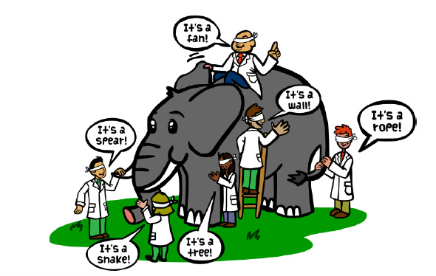
Summary of The Problem
Lack of common vision and understanding
http://theblindelephant.com (used with permission)

Slide 24
Summary of Requirements Challenges
Failures due to requirements are
Often not technical
Related to
Knowledge
Change
Communication
Health Information professionals are well positioned to address these challenges for healthcare systems

Slide 25
Requirements are Knowledge
Requirements are a form of knowledge
Knowledge must be learned, not gathered
Malcolm Knowles’ adult learning principles:
Adults need a reason to learn
Experience is the foundation for new knowledge
Adults need to be involved and responsible
Immediate relevance encourages learning
Adults are problem-centered versus content-centered
Internal motivation is more effective than external
Approaching requirements as knowledge to be constructed may help improve HIM project success rates

Slide 26
Evolution of Society
Lenski’s Typology of Society
Hunter/Gatherer
Horticultural
Agricultural
Industrial
Today
Information Age
Why are we still gathering requirements?
Proactively
Reducing Risk
(used with permission)
Constructing requirements means approaching requirements as knowledge to be proactively learned

Slide 27
Theories of Knowledge
Western Philosophy
Positivism
Ancient
700 B.C. – 400 A.D.
Plato, Aristotle, Socrates
Medieval
500 – 1700
Modern
1700 – Present
August Comte, 1830’s-40’s
Stages of quest for truth
Theological (divine influence)
Metaphysical (reason, nature, system)
Positive (observed, scientific, valid)
Foundation for scientific method
“The truth is out there”
Can be tested, observed, and proven
Great for physical world
Gathering requirements for HIM is a positivist approach
http://www.philosophybasics.com

Slide 28
Theories of Knowledge
Constructivism
Social Constructionism
Piaget, 1960’s
Physical world exists separately from our understanding of it
Knowledge is constructed by each individual based on previous experience
Berger and Luckmann, 1966
Knowledge is constructed by social interaction
Both are especially applicable to information systems requirements which are highly subjective

Slide 29
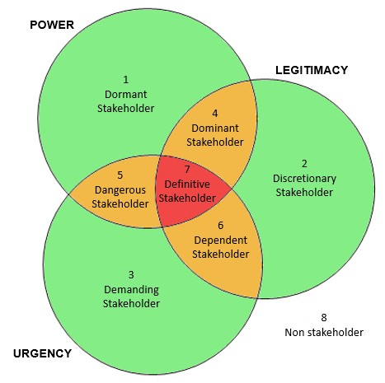
Stakeholder Theory
Stakeholder
“any group or individual who can affect or is affected by the achievement of the organization’s objectives” (Freeman, 1984)
Values
Serve all the stakeholders, not just the shareholders
Stakeholder salience
http://www.stakeholdermap.com (used with permission)

Slide 30
Waterfall Lifecycle
Traditional positivist approach

Slide 31
Agile Lifecycle
Constructivist Approach
http://zenexmachina.files.wordpress.com/2013/03/scrum.jpg

Slide 32
Lifecycle Models
Waterfall
Agile
Regardless of model, we must construct the right requirements

Slide 33
Recommendations
Involve all stakeholder groups in collaboration
Limit turnover, re-validate requirements
Resolve conflicting requirements ASAP
Resolve assumptions ASAP
Empower all stakeholders to fully engage
Recognize and address diverse perspectives
Balance egos and personal agendas with perceived success of the project

Slide 34
Recommendations
Approach requirements as a proactive, collaborative, creative learning activity
Watch for and address obstacles to common vision and understanding
Don’t accept challenges as “normal”
“Normal” too often leads to failure
Stop gathering requirements
Advocate for constructing requirements

Slide 35
Recommendations
A change of attitude or culture about requirements
Focus on eliciting the right requirements
From the right people
Stakeholders who evaluate success
http://www.robkendall.co.uk/982/
(used with permission)

Slide 36
Three-Legged Stool: Reimagined
People hold a special position
“One way to describe all the elements of an IS is to consider not only the hardware and software but also the people, policy, and process” (Amatayakul, 2013)
“People are the key reason for ISs to exist – and how they exist” (Amatayakul, 2013)
(Stakeholders)
People
Policy
Products (Technology)
Process

Slide 37
Questions
David Gibbs, PhD, CPHIMS
dgibbs@txstate.edu
@DrDavidGibbs
Please complete the session evaluation!

Slide 38
References
Amatayakul, M. (2013). Electronic Health Records: A practical guide for professionals and organizations (5th ed.). Chicago: AHIMA Press.
Berger, P. & Luckmann, T. (1967). The social construction of reality: A treatise in the sociology of knowledge. New York: Anchor.
Brooks, F. P. (1987). No silver bullet: Essence and accidents of software engineering. Computer, 20(4), 10-19.
Davey, B., & Cope, C. (2008). Requirements Elicitation - What's Missing? Issues in Informing Science and Information Technology, 5, 543-551. Retrieved from http://proceedings.informingscience.org/InSITE2008/IISITv5p543-551Davey466.pdf.

Slide 39
References continued
Davis, C. J., Fuller, R. M., Tremblay, M. C., & Berndt, D. J. (2006). Communication challenges in requirements elicitation and the use of the repertory grid technique. Journal of Computer Information Systems, 47, 78-86.
Freeman, R. E. (1984). Strategic management: A stakeholder approach. Boston: Pittman.
Knowles, M. (1980). The modern practice of adult education: From pedagogy to andragogy. Wilton, CT: Association Press.
Laplante, P. (2014). Requirements engineering for software and systems (2nd ed.). CRC Press.
Lenski, G., Nolan, P, & Lenski, J. (1995). Human societies: An introduction to macrosociology, (7th ed.). New York: McGraw-Hill.

Slide 40
References continued
Leviss, J. (2010). H.I.T. or miss: Lessons learned from health information technology implementations. Chicago: American Health Information Management Association.
Merhi, M. I. (2015). A process model leading to successful implementation of electronic health record systems. International Journal of Electronic Healthcare, 8(2-4), 185-201.
Piaget, J. (1954). The construction of reality in the child. New York: Routledge.
Reinersten, D. (2011). Forward. D. Leffingwell. Agile software requirements: Lean requirements practices for teams, programs, and the enterprise. Boston: Pearson.
Thomas, D., & Hunt, A. (2004). Nurturing requirements. IEEE Software, 21(2), 13-15.
Williams, H., & Duray, R. (2013). Making IT lean: Applying lean practices to the work of IT. CRC Press.

